Slide 1
PoC vs Prototype vs MVP
SE495: Software Entrepreneurship

Slide 2
Outline
Overview
PoC
Prototype
MVP
PoC vs. Prototype vs. MVP: Major Differences

Slide 3
Overview

Slide 4
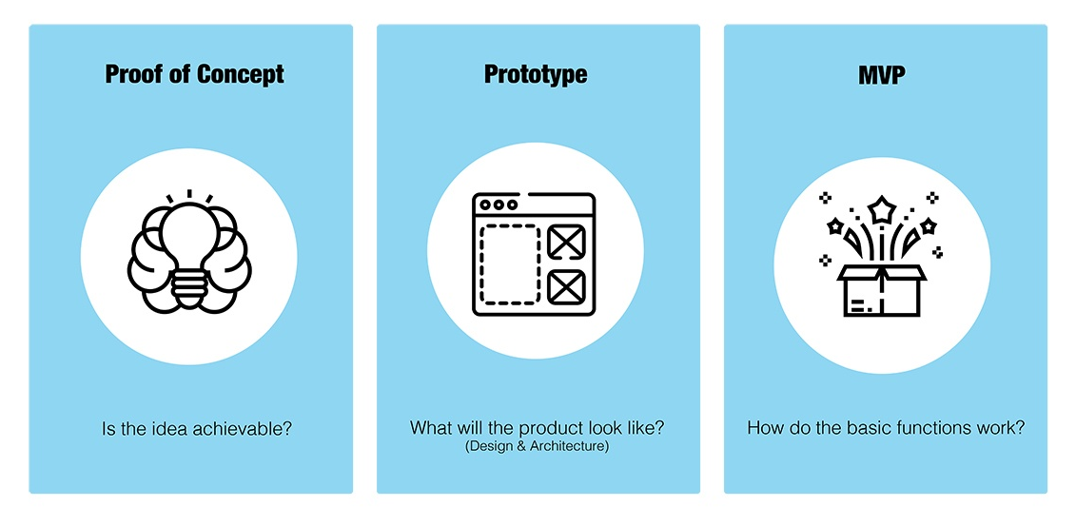
Overview
Proof of concept, prototype, and minimum viable product are more than mere industry jargon – they’re the foundational bricks that anchor any successful digital product.

Slide 5
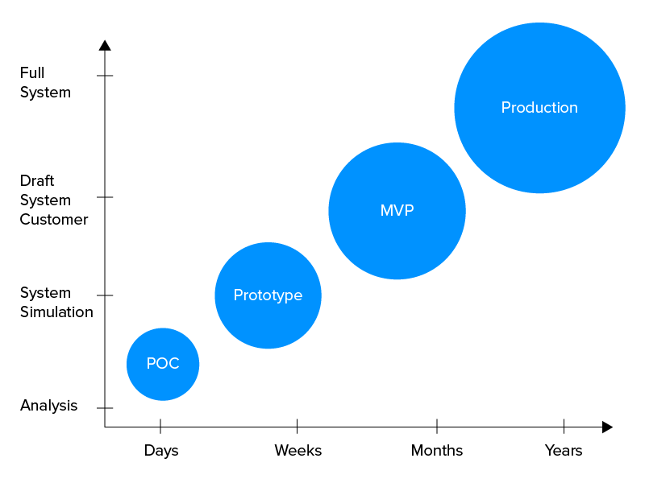
Overview
Dive into the world of startups, and you’ll soon realize just how crucial these terms become.
While each term refers to a different process, they’re the guiding lights that help entrepreneurs translate their dreams into reality.

Slide 6
Which one does a startup need?
A startup typically needs to go through the following progression:
PoC - Validate the concept and technology.
Prototype - Test and validate key features, user interactions, and overall usability.
MVP - Launch a product with just enough features to gather feedback from early adopters and validate the product's value proposition.

Slide 7
PoC

Slide 8
What is PoC?
Proof of concept sounds a little like an arcane term you might hear from a research scientist in a lab, but in the world of startups, it plays an instrumental role.
At its core, a PoC is a litmus test for ideas.
A PoC seeks to answer a fundamental question:
Can this concept work in the practical world?

Slide 9
What is PoC?
PoC is more of a narrowly focused process. It zeros in on a specific design, project, or assumption and puts it to the test.
This PoC process ensures that the seed of an idea can – in practice – grow into a full-fledged product you can be proud of.

Slide 10
How Does a Proof-of-Concept Work?
PoC is a small internal project carried out at the discovery stage of your product development project.
The creation of PoC involves;
Clear business plan to see your project from a different perspective.
Simplified introductory design
Verify your core idea to address the critical issues, and internal process flows. Outcomes are not meant to be shown to the end users.

Slide 11
How Does a Proof-of-Concept Work?
The PoC validates your idea’s practicality concerning the technical capabilities, resources, and tools.
So, if your idea is technically feasible, you can move ahead with the next stage of product development.
However, if your idea fails at this stage, PoC helps you save valuable resources, time, and funds in product development.

Slide 12
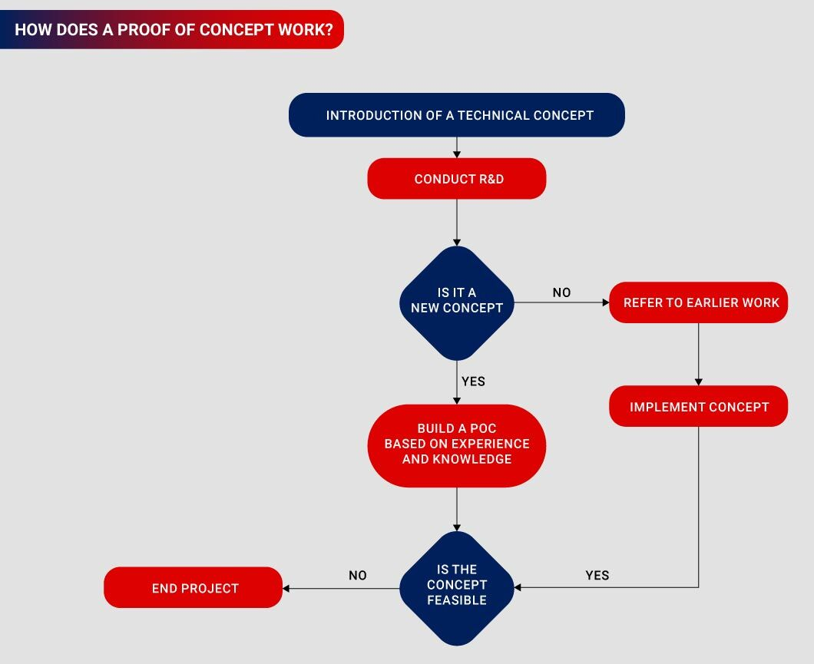

Slide 13
What are the Main Features of PoC?
Feasibility Check
Idea Exploration
Implementing a Small Part
Early Detection of Risks and Bugs
Cost and Time Saving
Simple Outcome

Slide 14
PoC Best Practices
Clarity of Purpose
Set Defined Parameters
Gather the Right Team
Document Everything
Solicit Feedback

Slide 15
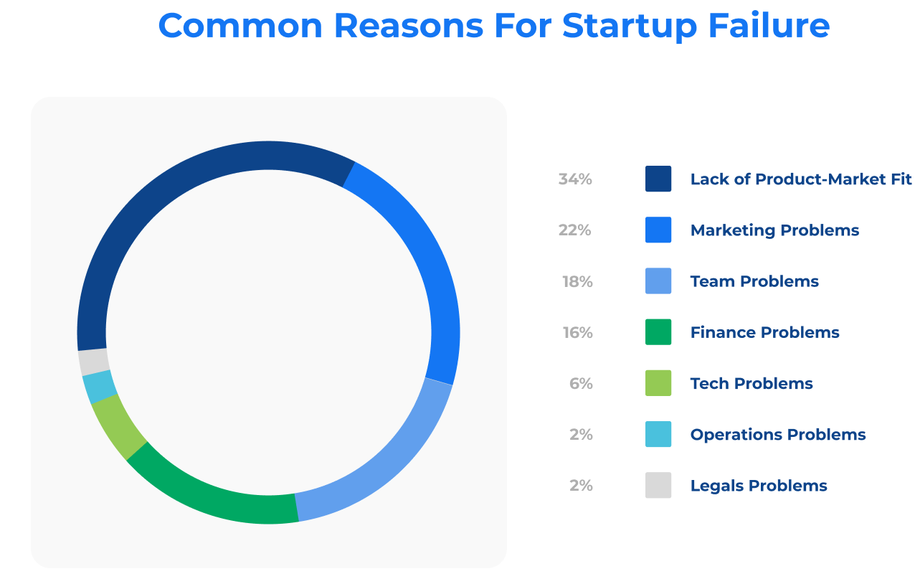
Why Do You Need to Use a PoC?
We’ve all heard the statistic that 90% of start-ups fail, and the majority of those failures occur within the early stages.

Slide 16
Why Do You Need to Use a PoC?
Well-executed PoC can make or break a start-up:
Validation
Risk Reduction
Cost-effective
Stakeholder Confidence

Slide 17
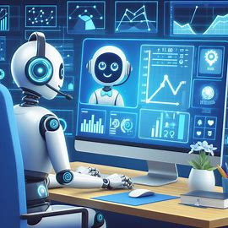
Examples
A startup wants to develop an AI-powered chatbot for customer service.
They create a basic PoC that integrates a machine learning model to answer frequently asked questions.
The PoC helps the startup validate the concept's potential and assess the technology's capabilities.

Slide 18

Examples
A startup wants to develop a new mobile app for fitness enthusiasts.
They create a PoC that integrates a machine learning model to analyze users' workout data and provide personalized recommendations.
The PoC helps the startup validate the concept's potential and assess the technology's capabilities.

Slide 19
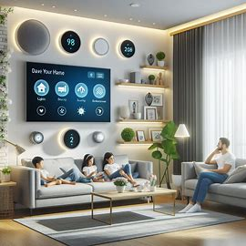
Examples
A startup wants to create a smart home automation system.
They build a PoC that connects a few devices, such as lights and thermostats, to a central hub.
The PoC helps the startup validate the feasibility of the system and identify potential challenges.

Slide 20
Prototype

Slide 21
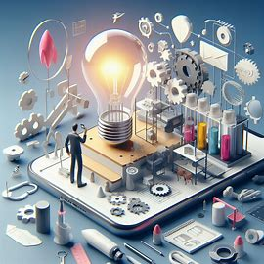
What is a Prototype?
While the PoC is considered the initial test for the feasibility of an idea, the prototype is a journey toward creating a product in a more usable form.
A prototype is a tangible or visual representation of your product that takes you several steps closer to the real deal.

Slide 22
What is a Prototype?
Think of a prototype as a draft.
It allows teams and stakeholders to visualize and interact with the core functionalities of the product.
More than just a sketch, it’s the first draft of the product, highlighting the anticipated user experience and journey.

Slide 23
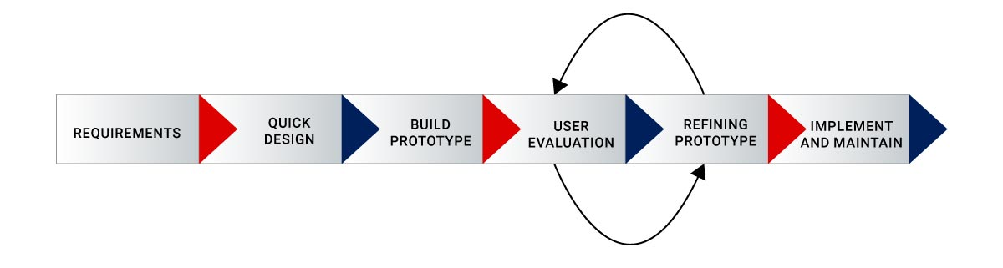
How Does Prototyping Work?
The development of a prototype starts with a product owner defining objectives and system requirements to create a working solution with a preliminary design.

Slide 24
How Does Prototyping Work?
Once the initial design is done and the prototype is built, it involves brainstorming of basic representation to identify essential features and functionalities.
The form of the prototype depends on your product and the specific features you wish to test and demonstrate.
By gathering valuable feedback and insights on your prototype, you can improve your concept, get valuable insights, and make informed decisions for the successful development of your product.

Slide 25
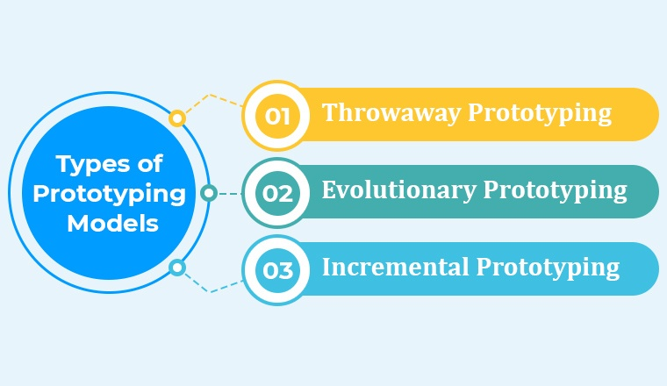
Major Prototype Models

Slide 26
Major Prototype Models
Throwaway/Rapid Prototyping
This is the sprinter of prototypes.
Crafted swiftly, it represents specific aspects of interest.
It serves its purpose, garners feedback, and then gracefully exits the stage, allowing the actual product to be developed with newfound clarity.

Slide 27
Major Prototype Models
Evolutionary Prototyping
Consider this the long-distance runner.
Starting with a basic version, it undergoes numerous iterations.
Each round hones the prototype based on invaluable user feedback, gradually sculpting it closer to the final masterpiece.

Slide 28
Major Prototype Models
Incremental Prototyping
This model takes a modular approach.
Envision building a product as assembling a puzzle; each prototype is a piece of that puzzle.
They're crafted, refined, and perfected individually, eventually coming together to unveil the complete picture.

Slide 29
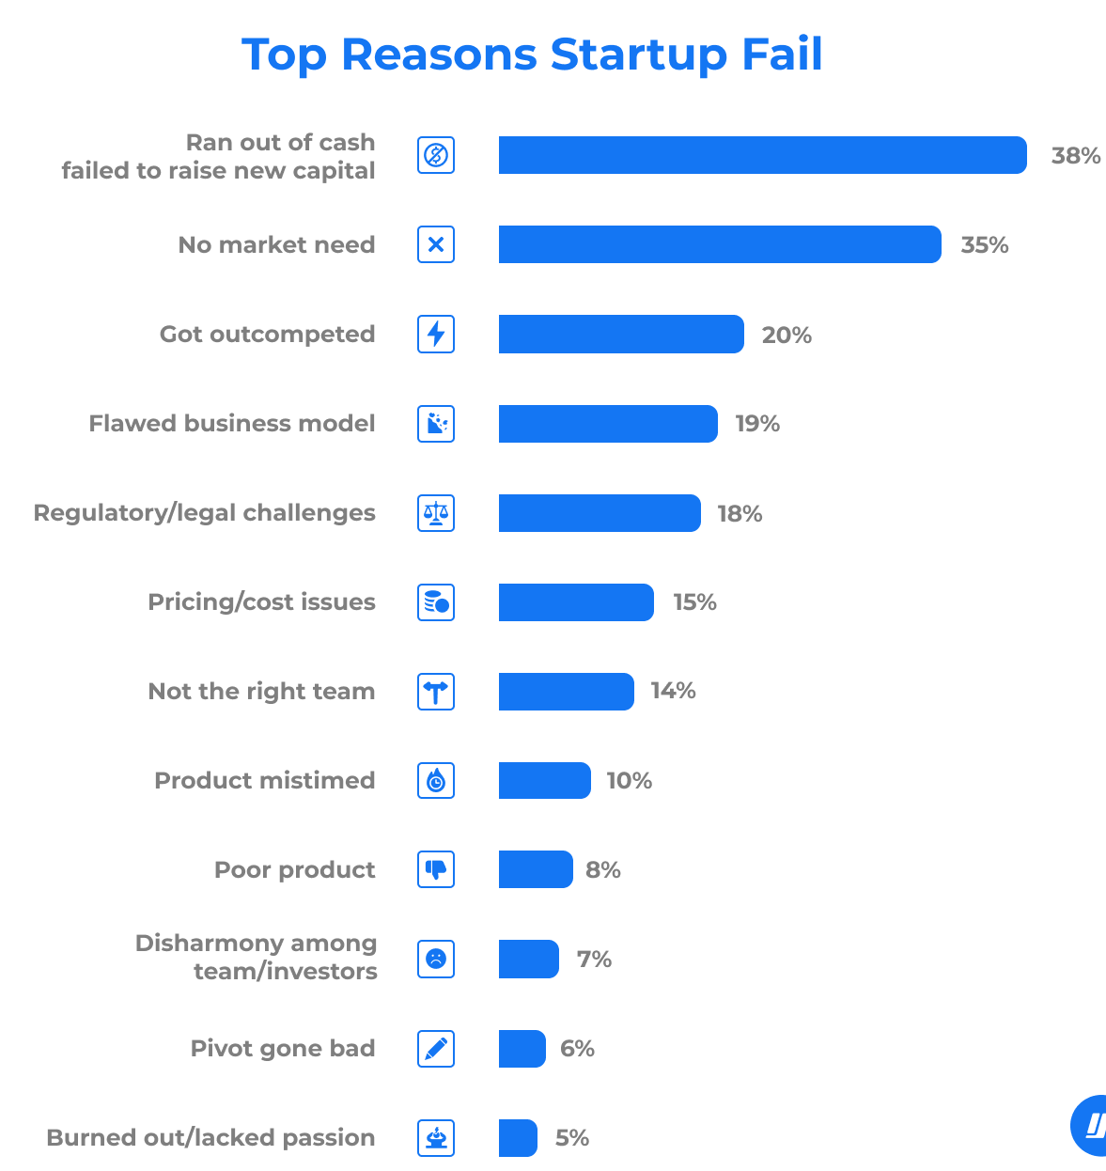
Why Do You Need a Prototype?
Prototyping isn't just a buzzworthy phase in product development, it's a critical step that can spell the difference between success and obscurity.

Slide 30
Prototyping becomes evident
Visualization
User Feedback
Design and Development Clarification

Slide 31
Prototyping Best Practices
Incorporate Realistic Content and Interactions
Map Out User Journeys
Foster Collaborative Design
Test Across Devices and Platforms
Continuously Test and Iterate

Slide 32

Examples
Building upon the chatbot example, the startup creates a prototype that incorporates natural language processing (NLP) and integrates with a messaging platform.
The prototype allows the startup to test the chatbot's functionality, user experience, and compatibility with different platforms.

Slide 33
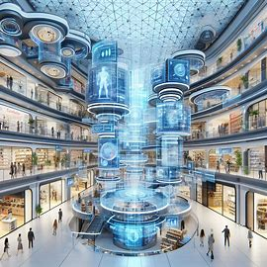
Examples
A startup wants to develop a new e-commerce platform.
They create a prototype that includes basic features such as product listing, search, and checkout.
The prototype helps the startup test the user experience, identify usability issues, and refine the product's requirements.

Slide 34

Examples
A startup wants to create a virtual reality game.
They build a prototype that includes basic gameplay mechanics, such as movement and interaction with objects.
The prototype helps the startup test the game's playability, identify areas for improvement, and iterate on the design.

Slide 35
MVP

Slide 36
What is an MVP?
What do Uber, Dropbox, Slack, and Figma all have in common?
It’s not just that they’re unicorn companies or giants in their respective fields, but also launched their projects with a minimum viable product (MVP).
The purpose of an MVP is to assess market and user acceptance, identify favored features, and determine what should be added in later stages of development.

Slide 37
MVP
An MVP embodies the essence of a product, stripped of all its frills yet functional and potent enough to offer genuine value to early adopters.
Key Characteristics of the MVP
Functionality
Iterative Process
Cost Efficiency

Slide 38
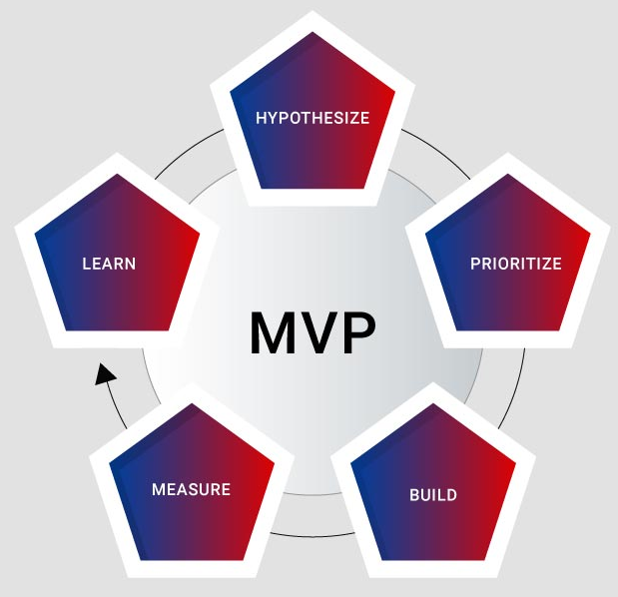
How Does an MVP Work?

Slide 39
How Does an MVP Work?
Identify a minimal set of features to address the value proposition and solve the problem.
Validate hypotheses and gauge demand while satisfying early adopters.
Offer a realistic user experience by providing a functional solution with clean code.
Prioritize user-generated data and feedback for refinement.
Minimal does not mean inferior; it emphasizes value-driven development based on user insights for early adopters to gather and analyze feedback.

Slide 40
Why Do You Need an MVP?
Early Market Entry
Feedback
Reduce Wastage

Slide 41
Main Characteristics of an MVP
Cost-effective Production
Core Feature Focus
Value-Driven
Targeted Audience
Iterative development

Slide 42
MVP Best Practices
Swift MVP Delivery
Handling Requirement Volatility
Selecting the Right Platform
Learning from MVP Setbacks

Slide 43
Examples
After testing the chatbot prototype, the startup decides to launch an MVP with basic features, such as answering frequently asked questions and directing customers to relevant support pages.
The MVP allows the startup to gather feedback from early adopters, identify pain points, and iterate to improve the chatbot's functionality and user experience.

Slide 44
Examples
A startup wants to develop a new social media platform.
They launch an MVP with basic features such as user profiles, news feeds, and messaging.
The MVP helps the startup gather feedback from early adopters, identify key features that are missing, and iterate on the product's development.

Slide 45
Examples
A startup wants to create a new online marketplace for freelancers.
They launch an MVP with basic features such as job posting, resume upload, and messaging.
The MVP helps the startup gather feedback from early adopters, identify pain points, and iterate on the product's development.

Slide 46
PoC vs. Prototype vs. MVP: Major Differences

Slide 47
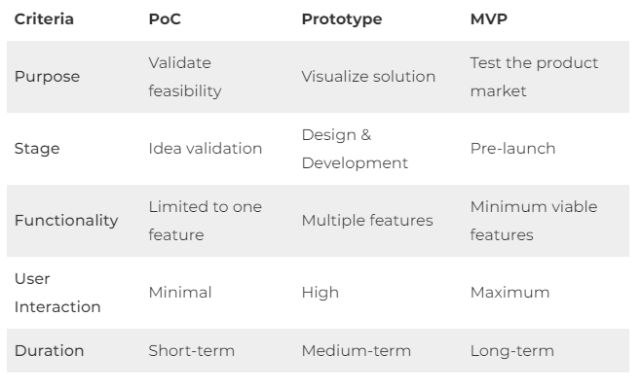
Differences

Slide 48
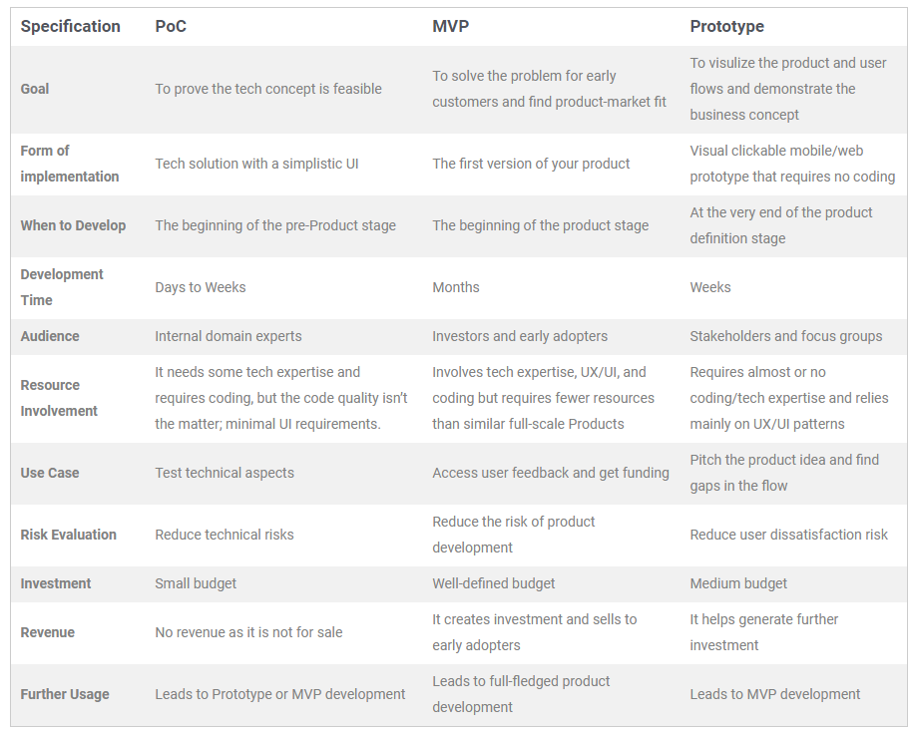

Slide 49
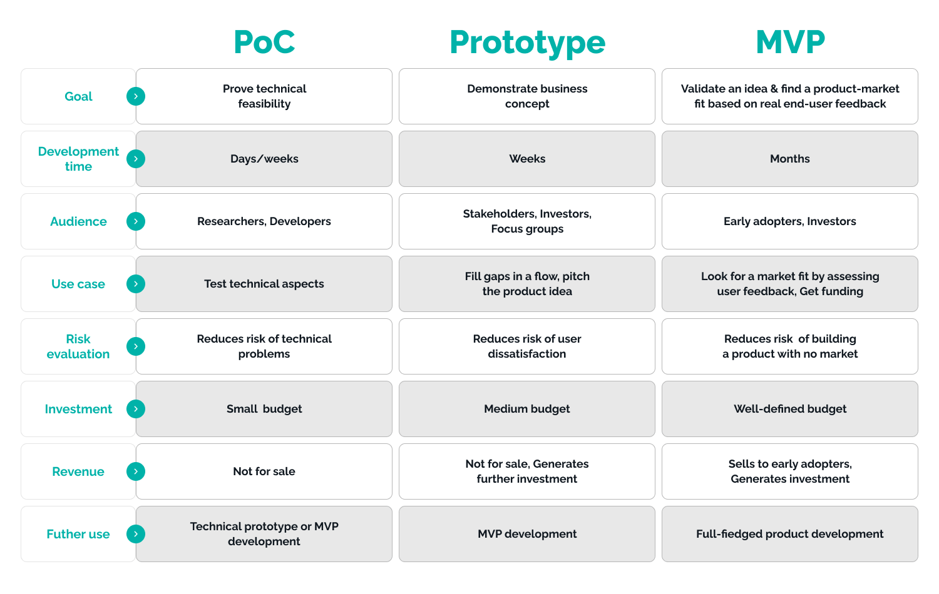

Slide 50
When to Use?
You can use a Proof of Concept (PoC) when:
Validate your new product idea before any sort of investment.
Share internal knowledge about your product idea with team members
Secure investment by verifying industrial utility.
To ensure your product’s industrial utility.
To make informed decisions before committing resources.

Slide 51
When to Use?
You can use a Prototype to:
Visualize the product’s flow, appearance, and experience.
To secure funds by showcasing design and user experience to investors.
Gather initial feedback from focus groups to validate the concept.
Meet tight deadlines when quick idea demonstration is needed.
Evaluate user acceptance before moving forward with development.

Slide 52
When to Use?
You must use an MVP when you want to:
Mitigate the risk of failure by validating assumptions with necessary features.
Optimize development by focusing on essential features with minimal time and cost investment.
Gather early user feedback as a foundation for iterative improvements.
Achieve higher customer retention at a lower cost and accelerate the monetization of your idea.

Slide 53
Conclusion
In essence, while a PoC establishes the feasibility of an idea, prototypes paint a vivid picture, visualizing how the entire system will operate and interact.
The minimum viable product, however, goes beyond these initial stages. It’s a tangible, albeit stripped-down, version of the product that seeks to quench the early user's thirst, gearing up for the market's larger appetite.

